Slide 1
Introduction to Dapper - ORM

Slide 2
Topics
What is Dapper
Benefits of Dapper
How does Dapper Work
ADO Database Object mapping versus Dapper Object Mapping
Where Do I get Dapper
Demo of Dapper with Visual Studio 2019

Slide 3
What is Dapper
Dapper is a popular simple object mapping tool. It is designed primarily to be used in scenarios where you want to work with data in a strongly typed fashion - as business objects in a .NET application, but don't want to spend hours writing code to map query results from ADO.NET data readers to instances of those objects. Dapper is an open source project under the Apache license. It is available as a Nuget package and has been downloaded over 16 million times
Dapper extends the IDbConnection by providing useful extension methods to query your database.

Slide 4
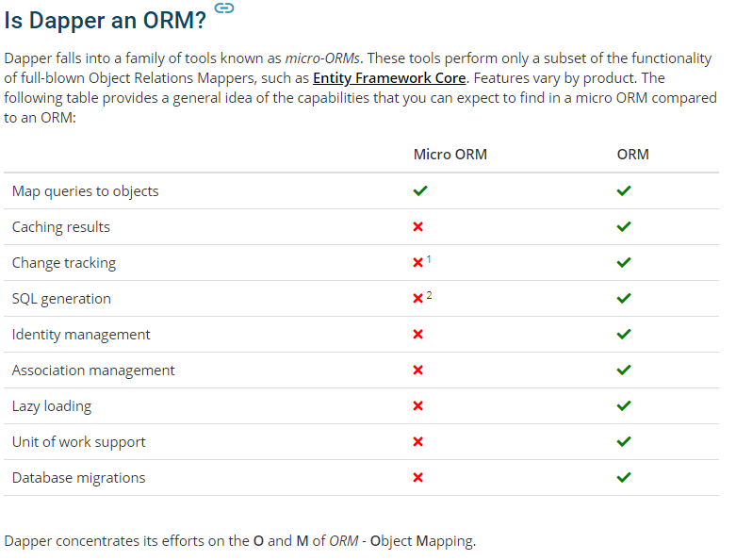
What is Dapper

Slide 5
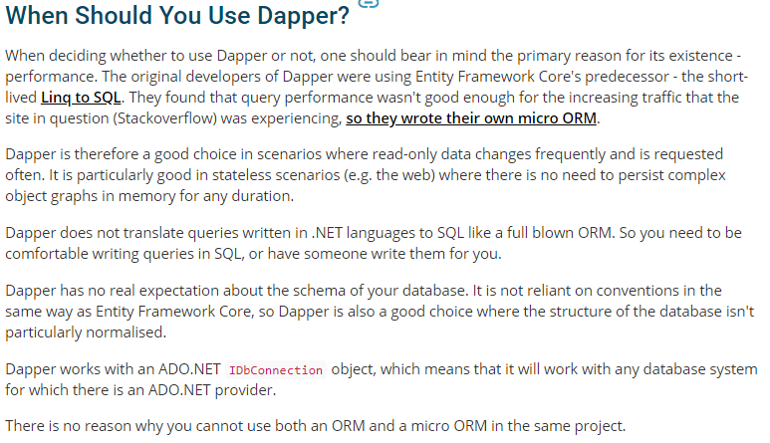
Benefits of Dapper

Slide 6
How Does Dapper Work
It is a three-step process.
Create an IDbConnection object.
Write a query to perform CRUD operations.
Pass query as a parameter in the Execute method.
Requirement
Dapper works with any database provider since there is no DB specific implementation.
Methods
Dapper will extend your IDbConnection interface with multiple methods:
  Execute
  Query
  QueryFirst
  QueryFirstOrDefault
  QuerySingle
  QuerySingleOrDefault
  QueryMultiple

Slide 7
ADO Object mapping vs
Dapper Object Mapping
Here is some standard ADO.NET code for retrieving data from a database and materializing it as a collection of Product objects:
var sql = "select * from products";
var products = new List<Product>();
using (var connection = new SqlConnection(connString))
{
connection.Open();
using (var command = new SqlCommand(sql, connection))
{
using (var reader = command.ExecuteReader())
{
var product = new Product
{
ProductId = reader.GetInt32(reader.GetOrdinal("ProductId")),
ProductName = reader.GetString(reader.GetOrdinal("ProductName")),
SupplierId = reader.GetInt32(reader.GetOrdinal("SupplierId")),
CategoryId = reader.GetInt32(reader.GetOrdinal("CategoryId")),
QuantityPerUnit = reader.GetString(reader.GetOrdinal("QuantityPerUnit")),
UnitPrice = reader.GetDecimal(reader.GetOrdinal("UnitPrice")),
UnitsInStock = reader.GetInt16(reader.GetOrdinal("UnitsInStock")),
UnitsOnOrder = reader.GetInt16(reader.GetOrdinal("UnitsOnOrder")),
ReorderLevel = reader.GetInt16(reader.GetOrdinal("ReorderLevel")),
Discontinued = reader.GetBoolean(reader.GetOrdinal("Discontinued")),
DiscontinuedDate = reader.GetDateTime(reader.GetOrdinal("DiscontinuedDate"))
};
products.Add(product);
}
}
}

Slide 8
ADO Object mapping
vs
Dapper Object Mapping
At its most basic level, Dapper replaces the highlighted assignment block of code on the previous slide with the following:
products = connection.Query<Product>(sql);
Dapper also takes care of creating the command and opening the connection if needed. If all you ever use Dapper for is for managing basic assignment like this, it will save you hours of time. In fact, Dapper is capable of doing quite a bit more.

Slide 9
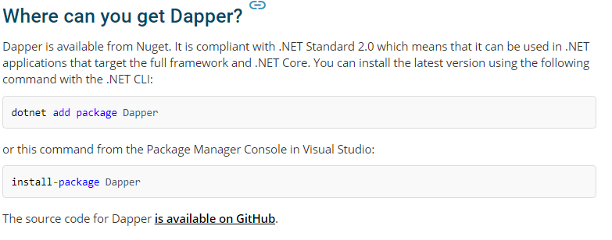
Where Do I get Dapper
Dapper is installed through NuGet: https://www.nuget.org/packages/Dapper
PM> Install-Package Dapper

Slide 10
Demo of Dapper with Visual Studio 2019
Download the DapperORM Demo VS 2019 template solution from Blackboard
Creating a local SQL Server Local Database aka SQL Server Express in Visual Studio or SQL Server Management Studio

Slide 11
Dapper - References
https://www.learndapper.com/
https://dapper-tutorial.net/dapper
Google search on Dapper and how to use Dapper

